Slide 1

E.G.S. Pillay Engineering College
An Autonomous Institution Affiliated to Anna University, Chennai | Approved by AICTE, New Delhi
Accredited by NAAC with A++ Grade | Accredited by NBA T1 (B.E. – CIVIL,MECH,EEE,CSE,ECE & B.Tech – IT)
Old Nagore Road, Thethi, Nagore Village, Nagapattinam – 611002, Tamil Nadu, India
Artificial Intelligence and Data Science
OmniOpt AI — Predictive Logistics & Fulfillment Platform
Career Craft Academy Powered by HCL
Presented by,
Akash.M (8208E23ASR006)
Aglaya.B (8208E23ASR003)
Afrid Ahamed.B (8208E23ASR002)
Abisheak.B (8208E23ASR001)
Akash.M (8208E23ASR005)

Slide 2
Introduction
OmniOpt AI is an AI-powered logistics and inventory management platform designed for modern e-commerce supply chains.
The system uses Machine Learning, real-time data processing, and intelligent warehouse rebalancing to predict product demand, optimize inventory levels, and reduce logistics costs.
It integrates:
Real-time demand forecasting
Inventory monitoring
Warehouse rebalancing
Route optimization
Live dashboard updates
Goal: Improve supply chain efficiency while reducing stockouts and overstocking.

Slide 3
Problem Statement
Modern e-commerce warehouses face several operational challenges that reduce the efficiency of supply chain management. Traditional inventory systems often produce inaccurate demand forecasts, resulting in frequent stockouts or excess inventory. Inventory updates are delayed, making it difficult to respond quickly to changing customer demand. In addition, high logistics and transportation costs, manual warehouse rebalancing, and the lack of real-time monitoring further reduce operational efficiency. Most existing systems also fail to consider external factors such as weather conditions and festivals, which significantly influence customer demand. As a result, these limitations increase operational costs, delay order fulfillment, and reduce overall customer satisfaction.

Slide 4
Existing System & Key Limitations
Existing System | Key Limitations
Moving Averages (MA): Uses rolling averages (7–30 days) for demand forecasting. | Cannot capture sudden demand spikes due to lagging predictions.
ARIMA Models: Forecasts demand using historical trends and statistical patterns. | Cannot effectively model complex multi-variable relationships (price, region, category).
Holt-Winters Smoothing: Handles seasonal demand variations. | Cannot incorporate external factors such as weather, festivals, or price changes.
EOQ / Reorder Point (ROP): Determines inventory replenishment based on fixed demand assumptions. | Performs poorly with dynamic and non-linear e-commerce demand patterns.
Manual Dispatch & Inventory Management: Uses spreadsheets and manual warehouse coordination. | Leads to slow decision-making, inefficient stock rebalancing, and human errors.
Cloud-Dependent Monitoring: Relies entirely on cloud connectivity for inventory visibility. | Network failures can interrupt real-time monitoring and reduce system reliability.

Slide 5
Proposed Solution
AI-Based Demand Forecasting: Uses Machine Learning to accurately predict future product demand.
Smart Inventory Management: Optimizes stock levels and automates warehouse rebalancing to reduce stockouts and overstocking.
Real-Time Monitoring: Provides live inventory updates and interactive dashboards using WebSockets.
Optimized Logistics: Improves delivery planning by considering factors such as weather, festivals, and route optimization.
5/13

Slide 6
Research Gap
Traditional forecasting models provide limited prediction accuracy.
Existing systems lack real-time inventory monitoring.
Warehouse rebalancing is mostly manual and inefficient.
External factors such as weather and festivals are ignored.
Forecasting and logistics operate independently.
Decision-making is slow due to manual processes.
Existing solutions are less scalable and adaptable for modern e-commerce.
6/13

Slide 7
Project Objectives with Outcomes
Objectives | Outcomes
Forecast product demand | Accurate sales prediction
Reduce stockouts | Better product availability
Optimize inventory | Lower holding cost
Enable real-time updates | Faster decision making
Automate warehouse rebalancing | Efficient stock transfer
Improve logistics routing | Reduced transportation cost
Increase system reliability | Continuous operation during failures

Slide 8
System Modules & Team Responsibilities
System Module | Team Member | Responsibilities
Integration Engineer | Akash.M | Managed the overall project, integrated frontend, backend, ML, and database modules, and ensured smooth system functionality.
Frontend Development | Agalya.B | Designed and developed the user interface, dashboards, charts, and responsive web pages for real-time monitoring.
Backend Development | Afrid Ahamed.B | Developed REST APIs using FastAPI, handled business logic, integrated WebSockets for real-time communication, and connected the frontend with ML and database modules.
ML Engineer | Abisheak.B | Built demand forecasting models, performed data preprocessing, feature engineering, model training, and prediction.
Database Management | Akash.M | Designed and managed the database, handled inventory and transaction data, and ensured efficient data storage and retrieval.
8/13

Slide 9
Technologies
Module | Technologies Used | Application
Frontend | Tailwind CSS, Chart.js, Leaflet.js, HTML5 | Dashboard UI, inventory charts, demand graphs, hub route mapping
Backend | FastAPI, Uvicorn, WebSockets, Python 3.10+ | REST API endpoints, ASGI server, real-time WebSocket broadcasting, CORS handling
Machine Learning | Scikit-Learn, LightGBM, HistGradientBoosting, Pandas, NumPy | Demand forecasting, ensemble regression, feature engineering, model selection
Database | JSON File Cache, File-lock (inventory_db.json) | Transaction storage, data persistence, seeding, read/write safety
9/13

Slide 10
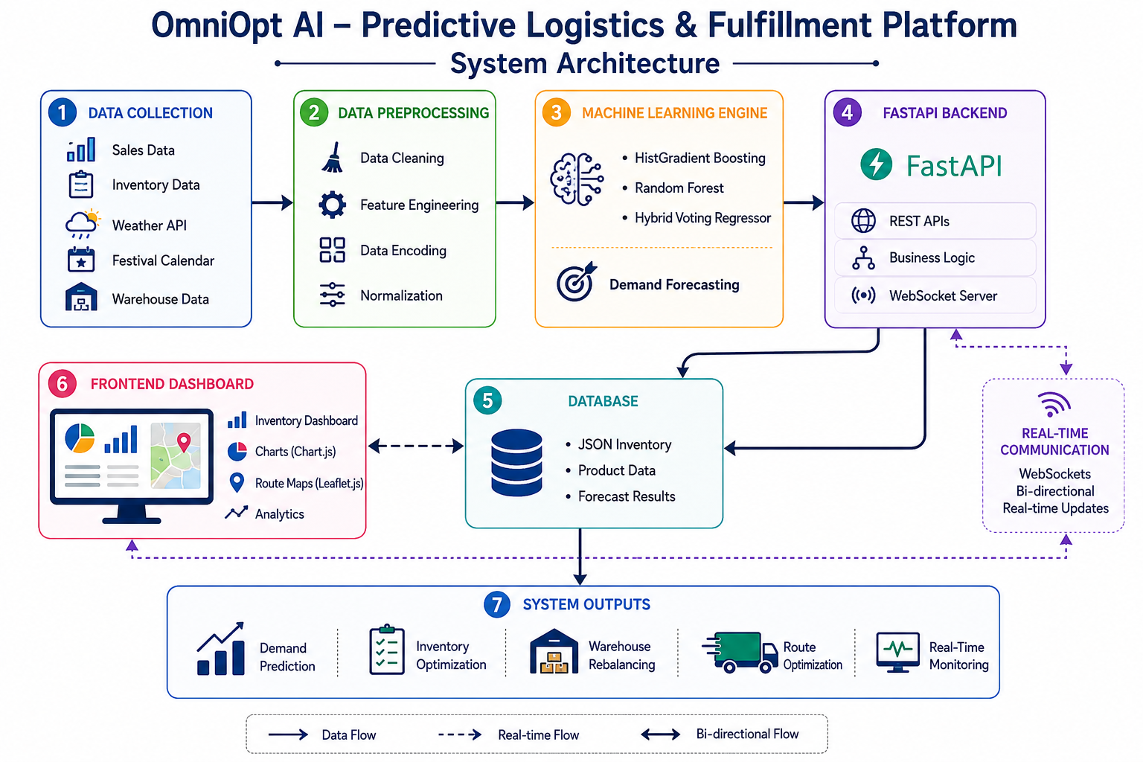

Slide 11
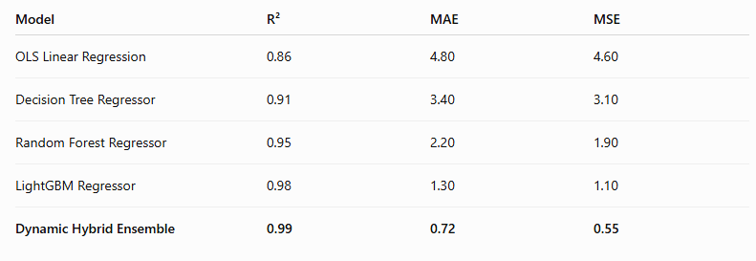
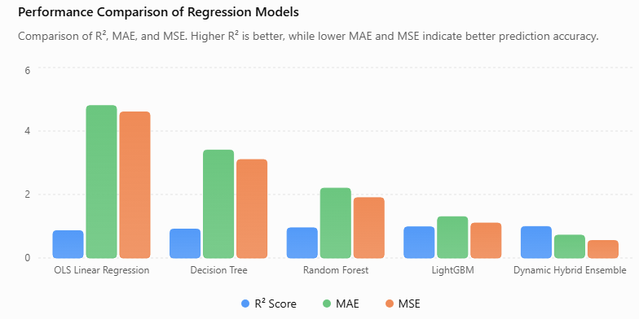
Key Results:

Slide 12
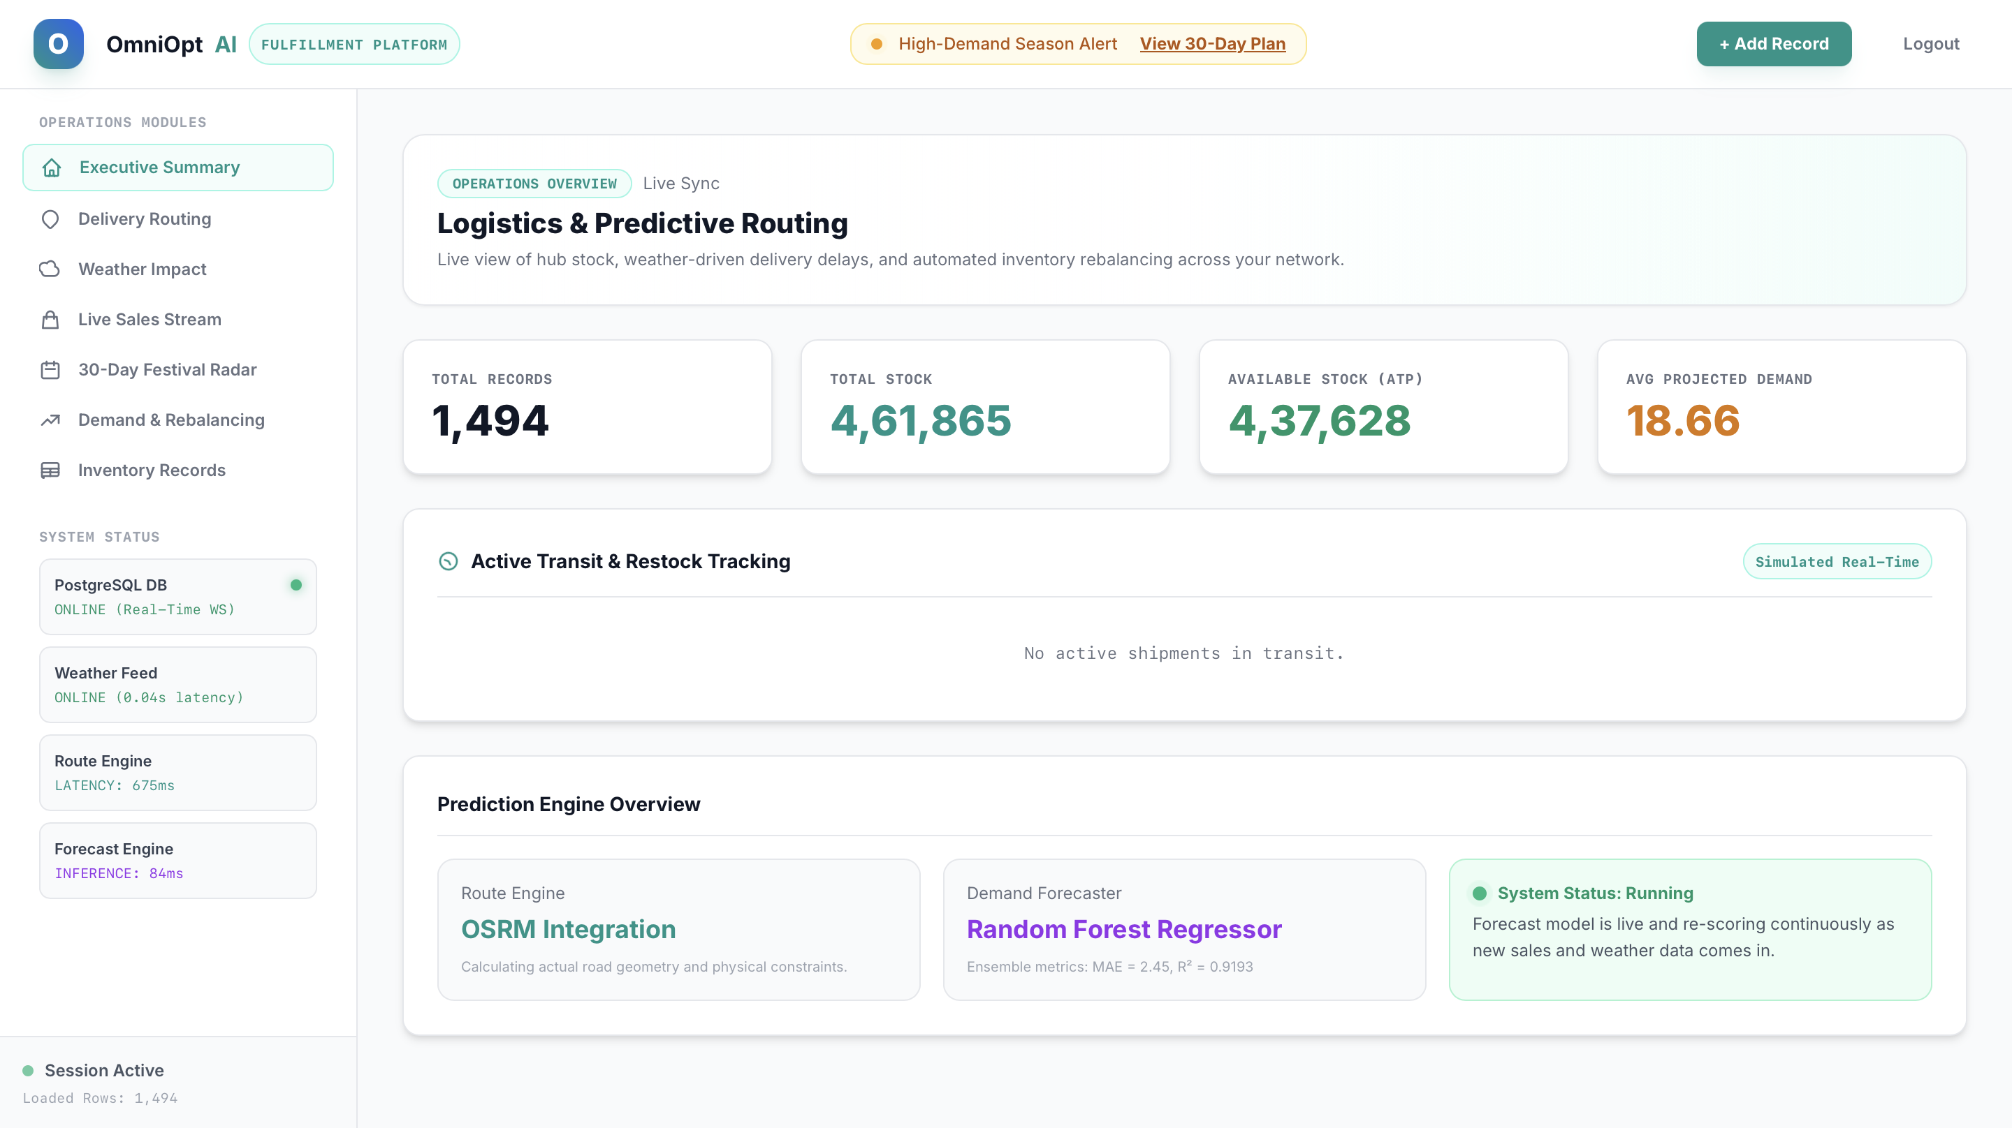

Slide 13
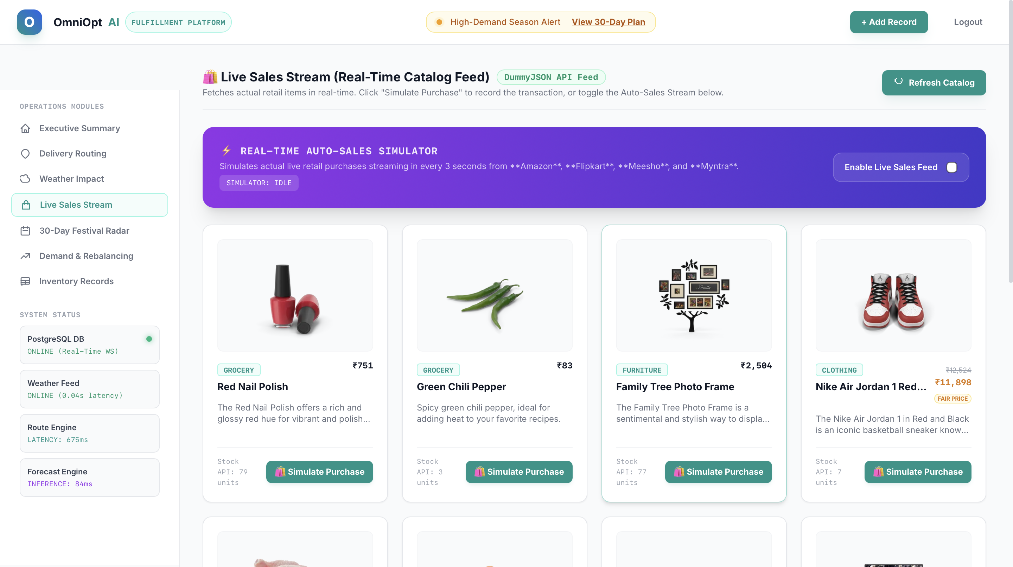


Slide 14
Conclusion
OmniOpt AI successfully transforms traditional inventory management into an intelligent, AI-driven logistics platform by integrating Machine Learning, FastAPI, WebSockets, and real-time dashboards. The system enables accurate demand forecasting, efficient inventory optimization, and automated warehouse rebalancing to improve overall supply chain performance. It provides several benefits, including higher forecasting accuracy, reduced logistics costs, fewer stockouts, real-time monitoring, and improved operational efficiency. With a scalable and reliable architecture, the proposed system offers a practical and effective solution for modern e-commerce supply chain management.

